Slide 1
File handling example
Lab 12

Slide 2
File Systems

Slide 3
What is a File?
File is a named persistent collection of data
Unstructured, sequential (UNIX)
Data is accessed by specifying the offset
Collection of records (database systems)
Supports associative access
give me all records with “Name=Yossi”
Attributes: owner, permissions, modification time, size, etc…

Slide 4
File Attributes
Name – only information kept in human-readable form
Identifier – unique tag (number) identifies file within file system
Type – needed for systems that support different types
Location – pointer to file location on device
Size – current file size
Protection – controls who can do reading, writing, executing
Time, date, and user identification – data for protection, security, and usage monitoring
Information about files are kept in the directory structure, which is maintained on the disk

Slide 5
Directories
Files are Kept in Directories which are logical groupings of files.
The advantages of Directory Structures are:
Efficiency – locating a file quickly
Naming – convenient to users
Two users can have same name for different files
The same file can have several different names
Grouping – logical grouping of files by properties

Slide 6
What we do with Files
Search for a file
Create a file
Delete a file
List a directory
Rename a file
Traverse the file system

Slide 7
What can you do with Files
File data access
READ: Bring a specified chunk of data from file into the process virtual address space
WRITE: Write a specified chunk of data from the process virtual address space to the file
CREATE, DELETE, SEEK, TRUNCATE
open, close, set_attributes

Slide 8
File Handling in C
Files need to be opened before use.
Associate a "file handler" to each file
Modes: read, write, or append
File input/output functions use the file handler (not the filename).
Need to close the file after use.
Basic file handling functions: fopen(), fclose(), fscanf(), fprintf().

Slide 9
File I/O Example
Write a program which:
inputs a list of names from a file called names.lst
counts the number of names in the list
asks a mark for each name in the file
outputs the name and corresponding mark to the file names_marks.dat
Note: the tasks above are not necessarily accomplished in that order.

Slide 10
Steps in Processing a File
Create the stream via a pointer variable using the FILE structure: FILE *p;
Open the file, associating the stream name with the file name.
Read or write the data.
Close the file.

Slide 11
The basic file operations are
fopen - open a file- specify how its opened (read/write) and type (binary/text)
fclose - close an opened file
fread - read from a file
fwrite - write to a file
fseek/fsetpos - move a file pointer to somewhere in a file.
ftell/fgetpos - tell you where the file pointer is located.

Slide 12
File I/O (File Pointer)
Step 1: Declare a file handler (a.k.a. file pointer) as FILE * for each file.
int main()
{
FILE *inputfile = NULL;
FILE *outputfile = NULL;
FILE *currentfile = NULL;
...
return 0;
}

Slide 13
File Open
The file open function (fopen) serves two purposes:
It makes the connection between the physical file and the stream.
It creates “a program file structure to store the information” C needs to process the file.
Syntax: filepointer=fopen(“filename”, “mode”);

Slide 14
More On fopen
The file mode tells C how the program will use the file.
The filename indicates the system name and location for the file.
We assign the return value of fopen to our pointer variable:
spData = fopen(“MYFILE.TXT”, “w”);
spData = fopen(“A:\\MYFILE.TXT”, “w”);

Slide 15
File I/O (Open)
Step 2: Open file using fopen().
int main()
{
FILE *inputfile = NULL;
FILE *outputfile = NULL;
FILE *currentfile = NULL;
inputfile = fopen(“Names.txt”, “r”);
outputfile = fopen(“marks.dat”, “w”);
currentfile = fopen(“logFile.txt”, “a”);
...
return 0;
}

Slide 16
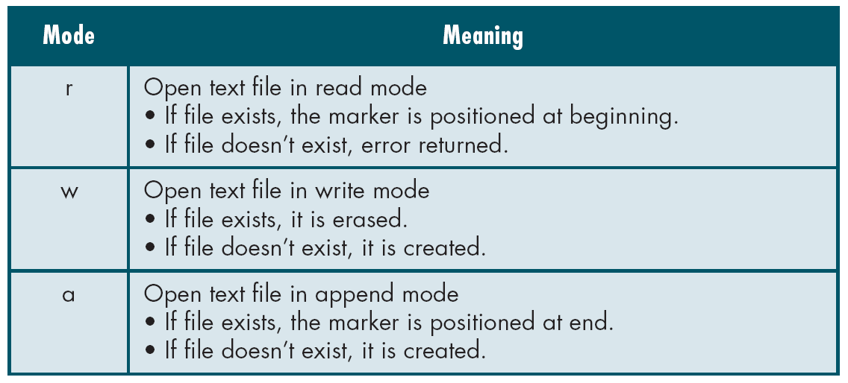
File Open Modes
from Table 7-1 in Forouzan & Gilberg, p. 400

Slide 17
Additionally,
r+ - open for reading and writing, start at beginning
w+ - open for reading and writing (overwrite file)
a+ - open for reading and writing (append if file exists)

Slide 18
File I/O (Error Check)
Step 3: Check if file is opened successfully.
int main()
{
FILE *inputfile;
inputfile = fopen(“Names.txt”, “r”);
if (inputfile == NULL)
{
printf(“Unable to open input file.\n”);
return 1;
}
...
return 0;
}

Slide 19
File I/O (Error Check)
Step 3: Check if file is opened successfully.
int main()
{
FILE *inputfile;
inputfile = fopen(“Names.txt”, “r”);
if (inputfile == NULL)
{
printf(“Unable to open input file.\n”);
return 1;
}
...
return 0;
}

Slide 20
File I/O (Error Check)
Step 3: Check if file is opened successfully.
int main()
{
FILE *inputfile;
inputfile = fopen(“Names.txt”, “r”);
if (inputfile == NULL)
{
printf(“Unable to open input file.\n”);
return 1;
}
...
return 0;
}

Slide 21
File I/O (Input)
Step 4a: Use fscanf() for input.
#include <stdio.h>
#define MAXLEN 100
int main()
{
FILE *inputfile = NULL;
char name[MAXLEN];
int count;

Slide 22
File I/O (Input)
Step 4a: Use fscanf() for input.
/* Assuming "names.lst" contains a
list of names, open this file for
reading. */
inputfile = fopen("names.lst", "r");
if (inputfile == NULL)
{
printf("Error opening names file.\n");
return 1;
}

Slide 23
File I/O (Input)
Step 4a: Use fscanf() for input.
/* Read in each name, and keep count how
many names there are in the file. */
count = 0;
while ( fscanf(inputfile, "%s", name) == 1 )
{
count++;
printf("%d. %s\n", count, name);
}
printf("\nNumber of names read: %d\n", count);
return 0;
}

Slide 24
File I/O (Output)
Step 4b: Use fprintf() for output.
#include <stdio.h>
#define MAXLEN 100
int main()
{
FILE *inputfile = NULL;
FILE *outfile = NULL;
char name[MAXLEN];
int count;
float mark;
/* Assuming "names.lst" contains a list of names,
open this file for reading. */
inputfile = fopen("names.lst", "r");
if (inputfile == NULL)
{
printf("Error opening names file.\n");
return 1;
}

Slide 25
File I/O (Output)
Step 4b: Use fprintf() for output.
/* The output file "names_marks.dat" will
contain the list of names and
corresponding marks. */
outfile = fopen("names_marks.dat", "w");
if (outfile == NULL)
{
printf("Error opening output file.\n");
return 1;
}

Slide 26
File I/O (Output)
Step 4b: Use fprintf() for output.
/* Read in each name, ask for the mark, and write name and mark to
output file. Also keep count how many names there are in the
file. */
count = 0;
while ( fscanf(inputfile, "%s", name ) == 1 )
{
count++;
printf("Enter mark for %s: ", name);
scanf("%f", &mark);
if ( fprintf(outfile, "%s %f\n", name, mark) <= 0 )
{
printf("Error writing to output file.\n");
return 1;
}
}
/*** etc ***/

Slide 27
Closing a File
When we finish with a mode, we need to close the file before ending the program or beginning another mode with that same file.
To close a file, we use fclose and the pointer variable: fclose(spData);

Slide 28
File I/O (Close)
Step 5: Close file using fclose()
int main()
{
/*** etc ***/
printf("\n");
printf("Number of names read: %d\n", count);
fclose(inputfile);
fclose(outfile);
return 0;
}

Slide 29
File I/O (Close)
Step 5: Close file using fclose()
int main()
{
/*** etc ***/
printf("\n");
printf("Number of names read: %d\n", count);
fclose(inputfile);
fclose(outfile);
return 0;
}

Slide 30
Notes on Filenames
Unless a directory path is specified, the program will look for the file in the current directory.
Directory paths in filenames: DOS/Windows
sysFile = fopen(“C:\\win\\system.ini”, “r”);
Directory paths in filenames: Unix
passFile = fopen(“/usr/etc/passwd”, “r”);

Slide 31
Notes on Filenames
Variable filenames:
FILE *outFile = NULL;
char someName[MAX_NAME_LEN];
printf(“Please enter output filename: ”);
scanf(“%s”, someName);
outFile = fopen(someName, “w”);

